Slide 1
BRIEF ANALYSIS OF THE GAME BETWEEN PLYMOUTH ARGYLE AWAY TO HULL CITY ON 30 SEPTEMBER 2023
DATA FROM STATSBOMB

Slide 2
Welcome and Introduction
Welcome to our Data-Driven Analysis of Football Performance Presentation! Today, we delve into the intricate world of football analytics, exploring the power of data in understanding player and team performance. With insights sourced from Statsbomb, a leading authority in sports data, we have conducted some analysis to uncover valuable insights into the dynamics of the football match between Plymouth Argyle VS Hull City on the 30 September 2023.

Slide 3
What is Statsbomb?
Statsbomb stands as a pivotal player in the realm of sports analytics, providing cutting-edge and reliable football data. Their extensive database comprises a wealth of information, ranging from player statistics to intricate match details. Utilizing this rich source, analysis has been undertaken to offer a glimpse into the fascinating world of football analytics.

Slide 4
Methodology
In this analysis, we harnessed the power of PowerBI to dissect and visualize the data obtained from Statsbomb. Employing functions such as bins, we streamlined the dataset by grouping data points, ensuring a clear and concise analysis. The DAX/Measure function was implemented in simplifying and filtering the data, enabling us to focus on specific outcomes, notably 'won' within the 'outcome' column. This meticulous approach allows us to identify the players and teams that excelled in winning the ball back through dwell and interception.
The raw data, a valuable asset, was procured from Statsbomb in Excel format. It is imperative to emphasize the importance of reliable data sources such as Statsbomb. The accuracy and depth of their data significantly contributed to the insights gained from this analysis.

Slide 5
Analysis and Visualizations
In this analysis, various variables, including pass_success_probability, outcome_name, team_name, player_name, time_stamp, and minutes, among others were utilised, through these variables, we generated an array of visualizations, illuminating key aspects of team and player performance, they will be discussed in the following slides.

Slide 6
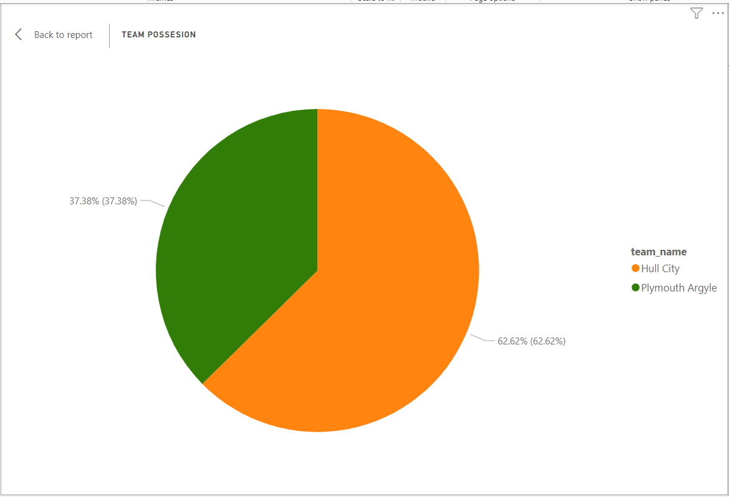
TEAM POSSESSION
This is a visual representation of team possession percentages, shedding light on ball control dynamics.
As it is evident, throughout the game Hull City enjoyed the most possession at 62.6% to that of Plymouth Argyle at 37.4%.

Slide 7
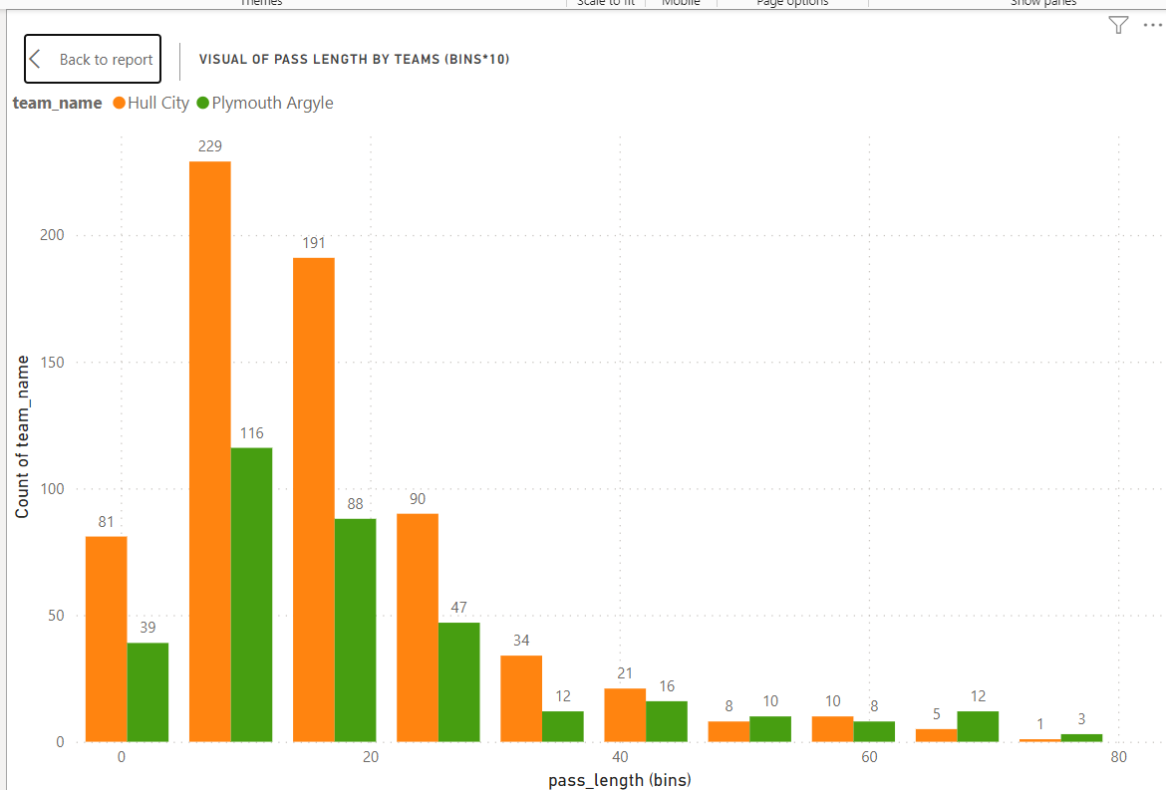
PASS LENGTH
Identification of teams and players with the longest and shortest pass lengths, revealing strategic nuances.
From this visual we can see that although Hull City had the most passes in general, Plymouth Argyle had more passes which are between the 40yard to 80yard range. This means Plymouth Argyle were more willing to go long with passes while Hull City looked to make shorter passes to keep possession.
N.B. The Bin function was used to create a Bin of 10 for this visual

Slide 8
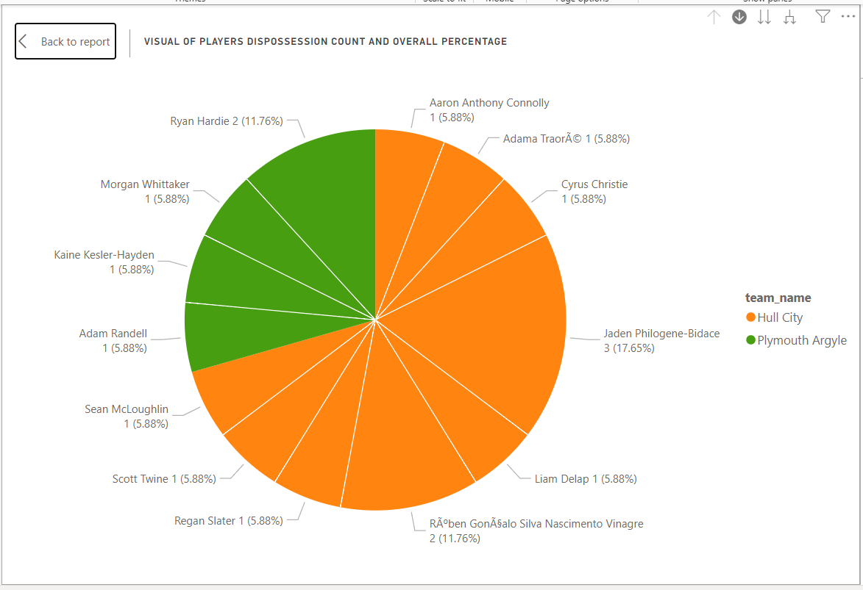
COUNT AND PERCENTAGE OF MOST DISPOSSESSED PLAYER ON THE PITCH
This visual reveals the players most frequently dispossessed in both teams, this may be highlighted as an area for improvement, but clearly Hull City have players higher on the rank in this category with two of their players losing the ball 3 and 2 times respectively. This also shows the determination to press and win the ball on the part of the Plymouth Argyle players.

Slide 9
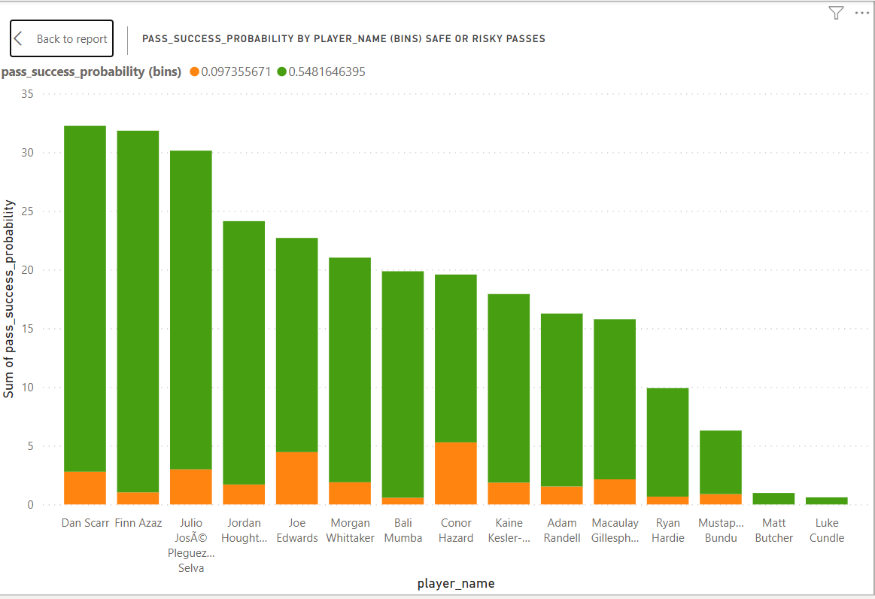
RISKY PASSES
A focused examination of players making high-risk passes, indicating bold gameplay strategy with intention to find their target.
From this visual we can see that amongst the Argyle players apart from the Goal Keeper who may not necessarily be considered for this metric, at least three other players made a considerable amount of passes with less probability of completion, which have now been termed ‘Risky Passes’ for this analysis.
N.B. A Bin of two equal halves was created with passes above 0.55 to be less risky passes, while passes below were higher risk passes as they had a higher probability to be misplaced.

Slide 10
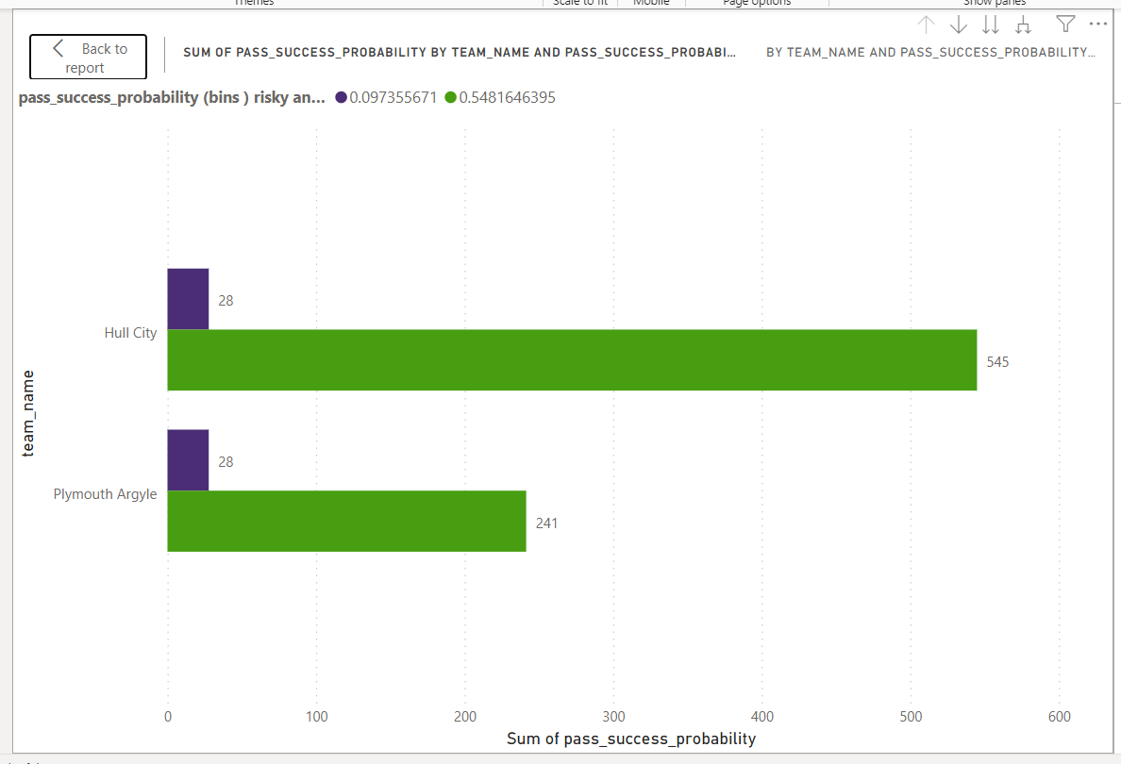
RISKY PASSES BY TEAM
A comparative study highlighting teams with the most daring passes, offering insights into tactical approaches.
Evidently by ratio of total completed passes to total risky passes, even though both teams had the same amounts of risky passes at 28 each, Argyle looked to have taken the most risky passes by ratio.
This highlights a daring strategy from the Manager.

Slide 11
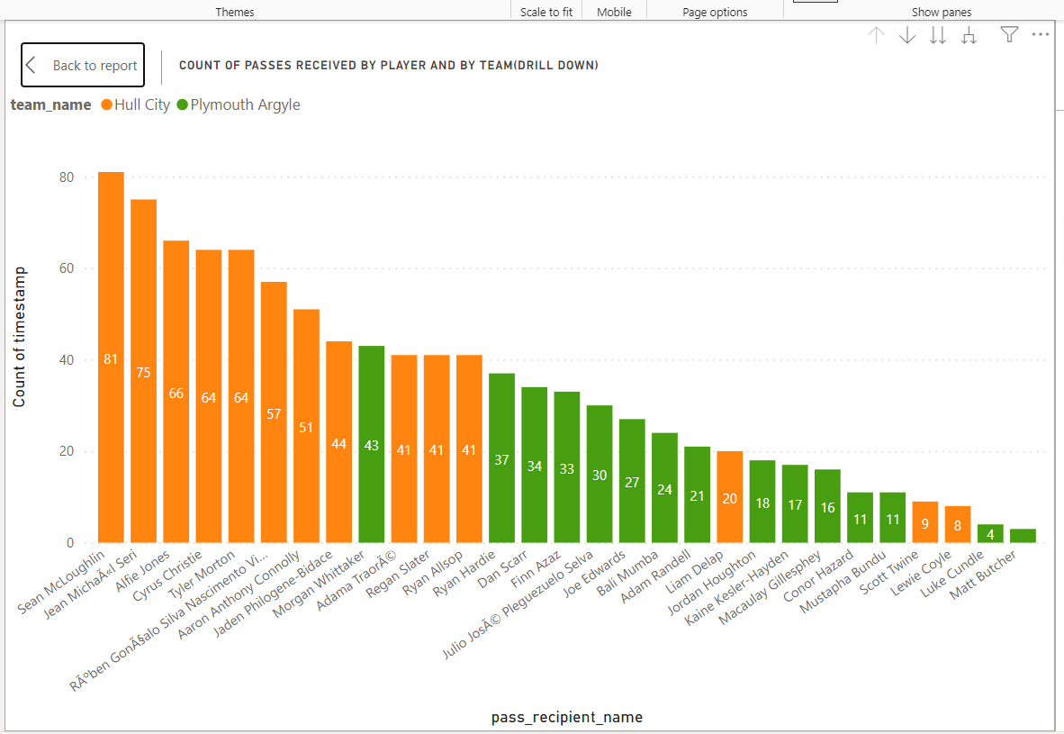
PLAYERS RECEIVING MOST PASSES FOR EACH TEAM
This visual helps to identify the players receiving the highest number of passes, showcasing their pivotal role in their respective teams.
For Argyle Morgan Whitaker received the most passes at 43, by Ryan Hardie at 37.

Slide 12
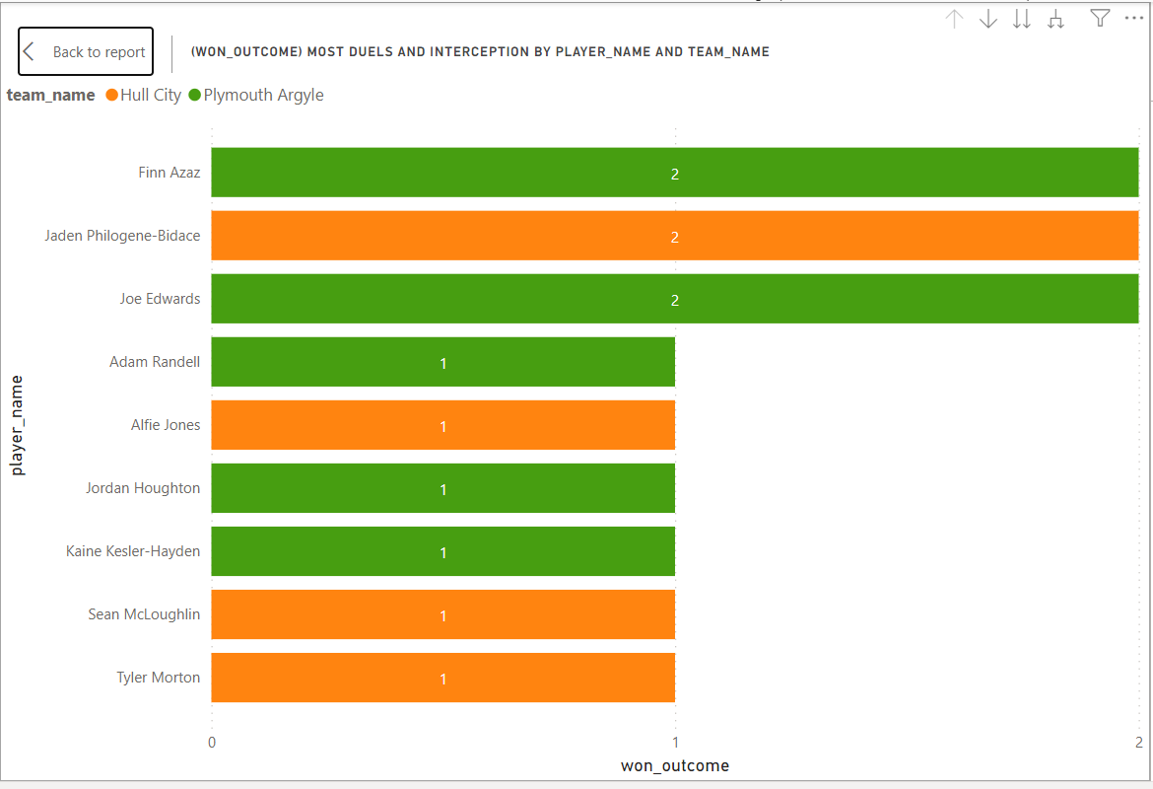
PLAYER WITH MOST DUELS WON
This visualisation identifies the player excelling in winning the most duels, based on interceptions and one on one duels, this showcases defensive prowess and ball winning capability.
Plymouth Argyle has five ball winners in this regard on this visual to Hull City’s 4 which affirms Plymouth Argyle’s defensive dominance over the home side.
Top of the list for Plymouth Argyle are Finn Azaz and Joe Edwards who tied at 2 each to help their team to be assured defensively.
N.B. A calculated measure or DAX function was use to obtain this insight on PowerBI by filtering the ‘won’ count in the ‘outcome’ column.

Slide 13
CONCLUSION
Overall the game in its entirety was a close affair with the possession not telling most of the story as Plymouth Argyle did enough in terms of strategy to gain something out of a game that could have gone either ways.
Playing away from home they were astute defensively and they were willing to take initiative to win the game as they were not trying to be conservative or safe with their passes, showing bravery and desire.

